Slide 1
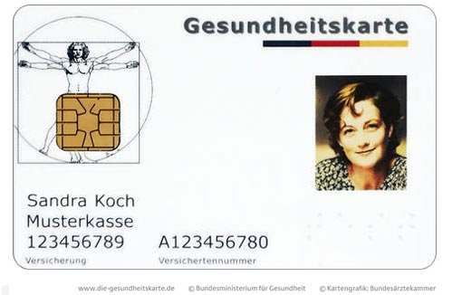
Secure Electronic Health Records:
The German Experience
By Michael Deighan

Slide 2
Concerned Parties
Patients
Doctors
Pharmacists
Hospitals
Insurance companies
Technology companies
Government

Slide 3
gematik
Gesellschaft für Telematikanwendungen der Gesundheitskarte
Formed in 2005
Charged with introducing and developing the use of the electronic card in health care
Public and private insurance, doctors, pharmacists, and hospitals
Creates standards
Certifies components
Conducts tests of the system

Slide 4
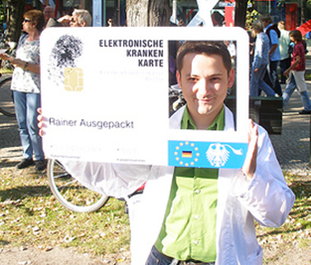
Critics
Doctor organizations
Consumer organizations
Gesellschaft für Informatik
Chaos Computer Club

Slide 5
Security Measures
Smart card for identification, encryption keys, and data storage
Two-key system
Hybrid encryption of data
Trusted hardware to handle communications
Broker as guard and monitor of online data
Audit log of each access

Slide 6
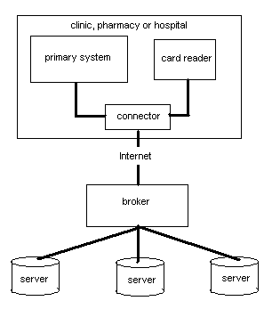
Basic Architecture

Slide 7
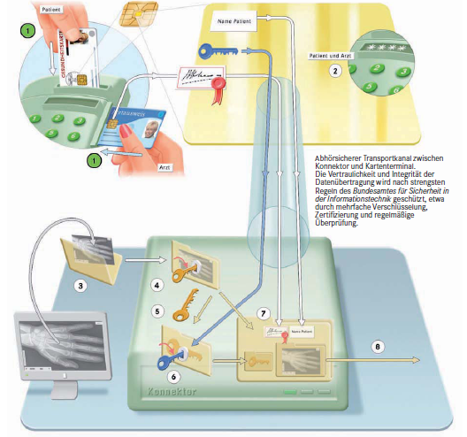
Document Encryption

Slide 8
Test Results
Seven test regions
10,000 patients per region
Level 1 testing
Flensburg: 75% of the patients and 30% of the doctors had trouble with the PIN
Some cards invalid due to certificate issues
Response time is an issue

Slide 9
Assessment
Complete mediation
Least privilege
Open design
Simple design
Exclusion of shared mechanisms
Multiple keys
User acceptance
Permission, not exclusion

